Slide 1
Regenerative Medicine/Anti-Aging Markets:
Sports Med/Pain Management; Hair restoration/Aesthetics; Sexual Wellness
Basic Biology of platelet growth factors-How PRP/cBMA fits into this space
Market Statistics
Applications/Call Points
FAQ’s

Slide 2
Regenerative Medicine Cell Based Therapies:
TruPRP and TruMAR0 overview
Christine Schroeder PA-C
National Sales Director-Tru

Slide 3
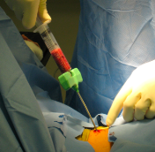
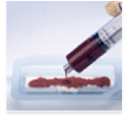
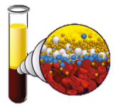
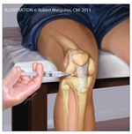
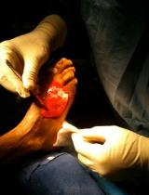
Hypothesis for Autologous Therapies
  The human body has built in repair mechanisms (Platelets and Nucleated cells) to recover from tissue injury. Concentrating those cells at the bedside and delivering to an injury site may:
          Accelerate the repair process
          Improve tissue function and quality
ASPIRATE
CONCENTRATE
DELIVER
Notes:
3

Slide 4
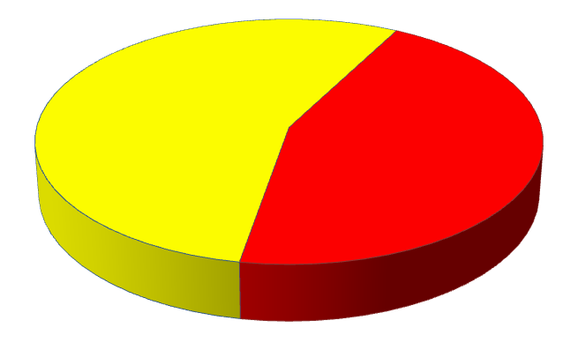

Cellular Content of Whole Blood
Composition of Whole Blood
Plasma
55%
Red Blood Cells
Cellular Component
45%
Breakdown of Cellular Component
Red Blood Cells
97%
Nucleated Cells
1%
Platelets
2%
Notes:
RBC’s are considered “background noise”. Important to remove the majority of these to concentrate platelets and wbc’s. Red blood cells will compete with the regenerative cells for oxygen and nutrients.

Slide 5
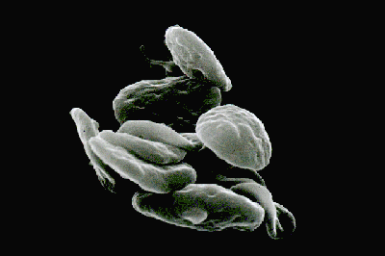
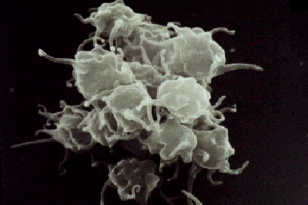
What is a Platelet?
Platelets or Thrombocytes are small disc-like, colorless, anuclear cells that play a major role in the coagulation and healing process.
Activated platelets will releases key growth factors involved in healing and tissue regeneration.
Resting platelet
Activated platelet
Notes:
Picure on the left is a resting platelet. On the right is an activated platelet.

Slide 6
Platelet Growth Factor Overview
Platelet Derived Growth Factor (PDGF)
  Released by the activated platelets.
  Powerful chemoattractant.
Transforming Growth Factor – Beta (TGF-β)
  Plays a major role in matrix formation and healing.
Vascular Endothelial Growth Factor (VEGF)
  Stimulates endothelial growth and angiogenesis
Fibroblast Growth Factor (FGF)
  Family of growth factors involved in angiogenesis, wound healing
Epidermal Growth Factor (EGF)
  Linked to angiogenesis and collagen deposition at wound sites.
  Shown to stimulate wound repair in fibroblasts and epithelial cells.
Insulin-life Growth Factor – 1 (IGF-1)
  Cellular recruitment
  Orchestrator of cellular proliferation
Notes:
Key properties of all growth factors: Signaling proteins (chemoattractants) call in all cells necessary for tissue healing and regeneration. Play a key role in angiogenesis(formation of a blood supply into the newly regenerated tissue.

Slide 7
What is Platelet-Rich Plasma(PRP)
Platelet count = 4 – 6 times baseline.
Must have a dual spin processing system
Anti-coagulant must be used
Must contain concentrated WBC’s
Marx. What is PRP and What is Not PRP
Hom. The Healing Effects of APG on Acute Human Skin Wounds

Slide 8
Important Considerations for PRP
PRP at 4-6 times baseline has more anti-inflammatory mediators and effects
PRP contains concentrated nucleated cells critical for healing/tissue regeneration including neutrophils, macrophages, lymphocytes and fibroblasts
Platelet activation should occur at the tissue level directly at the site of injury or just prior to injection d/t growth factor half life
¹
¹
Notes:
It is important that platelets remain in their resting state until reaching the injured tissue site due to the short half life of the majority of growth factors. A gentle processing system on the cells is extremely important.

Slide 9
Growth Factor Half Life (circulation)
VEGF – 3 min¹
PDGF – 2 min²
TGFB – 3min³
FGF – 3 min⁴
IGF-1 – 8 min⁵
EGF – 48 min⁶
¹ George. Clinical Cancer Research (2000) 6: 3147–3152.
² Cianciolo. Nephrol Dial Transplant (1999) 14: 2413-2419.
³ Massague. Annu Rev Biochem (1998) 67: 753-791.
⁴ Edelman. PNAS (1993) 90: 1513-1517.
⁵ Le Roith. NEJM (1997) 336:633-640.
⁶ Stocheck. JBC (1984) 98:1048-1053.
Notes:
It is important that platelets remain in their resting state until reaching the injured tissue site due to the short half life of the majority of growth factors. A gentle processing system on the cells is extremely important.

Slide 10
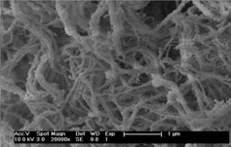
How and Why does PRP Fit?
Autologous: PRP provides a bio-active stimulant for tissue regeneration and remodeling. Matrix + Signal
Notes:
Autologous alternative to synthetic fillers that can be injected into all layers of the dermis

Slide 11
Stem Cell Basics
Two types of stem cells:
  Embryonic- Isolated from the inner cell mass of a blastocyst
Adult (found in adult tissues)
Stem cell definition/potential:
Stem Cells are cells characterized by the ability to renew themselves through mitotic cell divisions and differentiate into a diverse range of specialized cell types.
2 Types of Adult Stem Cells: Hematopoietic and Mesenchymal
Isto Biologic’s current focus- Bone marrow derived adult stem cells

Slide 12
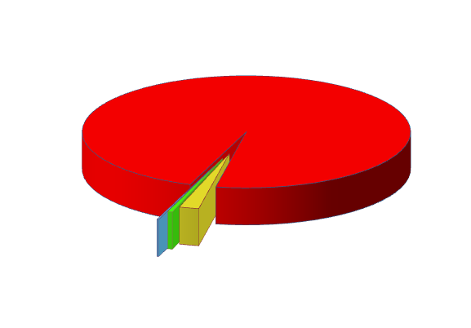
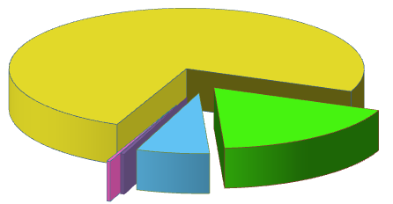
Cellular Content of Bone Marrow
Breakdown of Cellular Component of BMA
Red Blood Cells
93 - 97%
Breakdown of Cellular Component
(RBCs removed)
Nucleated Cells
1%
Platelets
2-6%
Platelets
75%
TNC
18%
MNC
7%
MSCs and HSCs
<3%

Slide 13
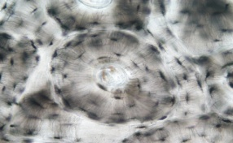
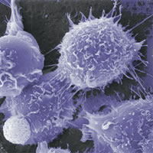
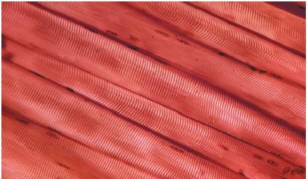
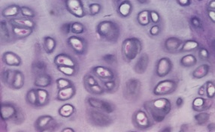
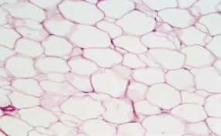
The Key Cells of Bone Marrow:
What is an MSC?
Mesenchymal Stem Cells are also Multipotent Cells
Gives Rise to Tissue Cells
Role in Tissue Regeneration
- Drawn to site injury
- Site of attachment
- Differentiation
Osteocyte
MSC
Myocyte
Chondrocyte
Adipocyte

Slide 14
Multipotentiality of MSCs to tissue repair
Replacement effect: Direct engraftment and proliferation/differentiation.
Trophic effect: Nourishment and cellular exertion on adjacent and local cells.
Bystander effect: MSCs produce factors that inhibit pro-inflammatory cytokines and are anti-scarring (fibrosis) and anti-apoptotic.
Notes:
Assum Biology is Problem
MSCs to repair
Replacement
Trophic
Bystander
Take a Deeper Dive

Slide 15
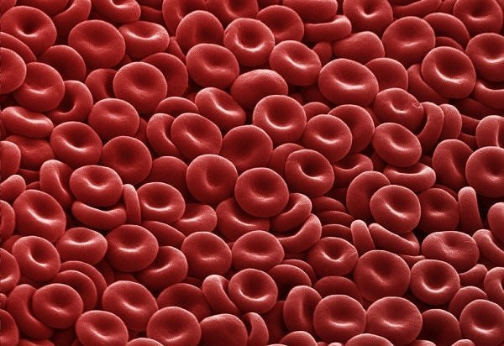
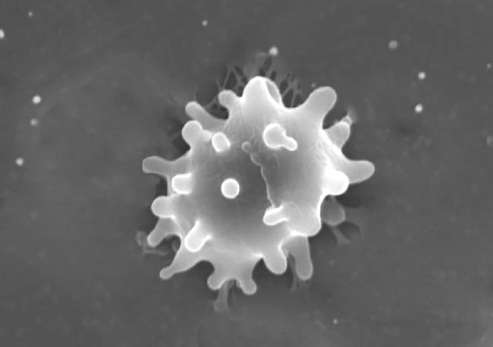

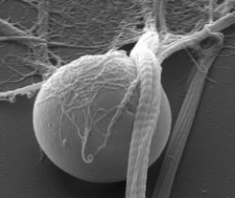
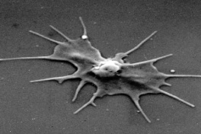
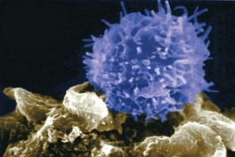
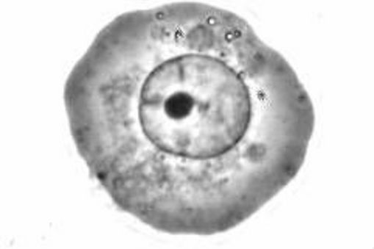
The Key Cells of Bone Marrow:
What is an HSC?
Hematopoietic Stem Cells are Multipotent Cells
Give Rise to Blood Cells
Role in Tissue Regeneration
RBC
Myeloid Progenitor Cell
WBC
Platelet
HSC
Lymphoid Progenitor Cell
T-Cell
B-Cell

Slide 16
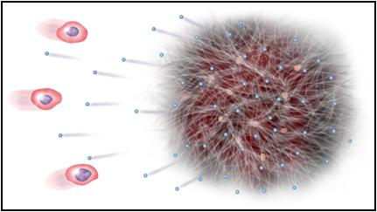
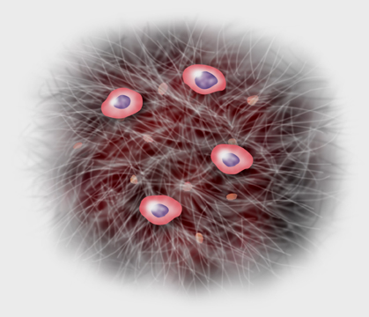
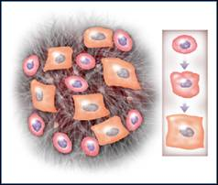
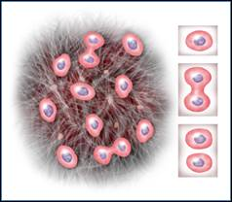
Targeting Natural, Biologic Processes
Mesenchymal Stem cell
Signaling protein
Chemoattraction
Fibrin matrix
Migration
Differentiation
Proliferation
Notes:
Simplistic picture of the natural biologic healing process which is enhanced and accelerated with PRP. 3 dimensional fibrin matrix with concentrated growth factors sending signals into the body to call in stem cells(regenerative cells). Stem cells attach to matrix, signals cause stem cell replication as well as differentiation.

Slide 17
Therapeutic Goal of PRP
Inflammatory
Proliferation
Regenerative
Pro
Anti
Normal Healing
Accelerated Healing
Cleansing
Debridement
Chemotaxis
Fiber accumulation
Matrix remodeling
Notes:
The goal of providing concentrated growth factors to a specific tissue site is to accelerate the natural healing and tissue regeneration process. When injecting PRP into tissue, the needle stick creates a tissue injury causing this process to begin.

Slide 18
Regenerative Medicine: All Encompassing
Anti-Aging Medicine: Statistical Data/Opportunity for TruPRP and TruMAR0
Applications in Pain Management/Sports Med
Applications in Aesthetics/Hair Restoration
Applications in Sexual Wellness

Slide 19
The Future of Medicine: Industry Statistics
Americans 50 years of age and older control 77% of this country’s financial assets and the buying power of this age group is projected to exceed $2 trillion dollars.
Over the next 10 years, population growth will be driven by a decrease in mortality not an increase in birth rate.
90 million adult American’s use alternative medicine
US Residents make 145 million visits for Medical aesthetics procedures each year and that number is expected to triple in the next 10 years.

Slide 20
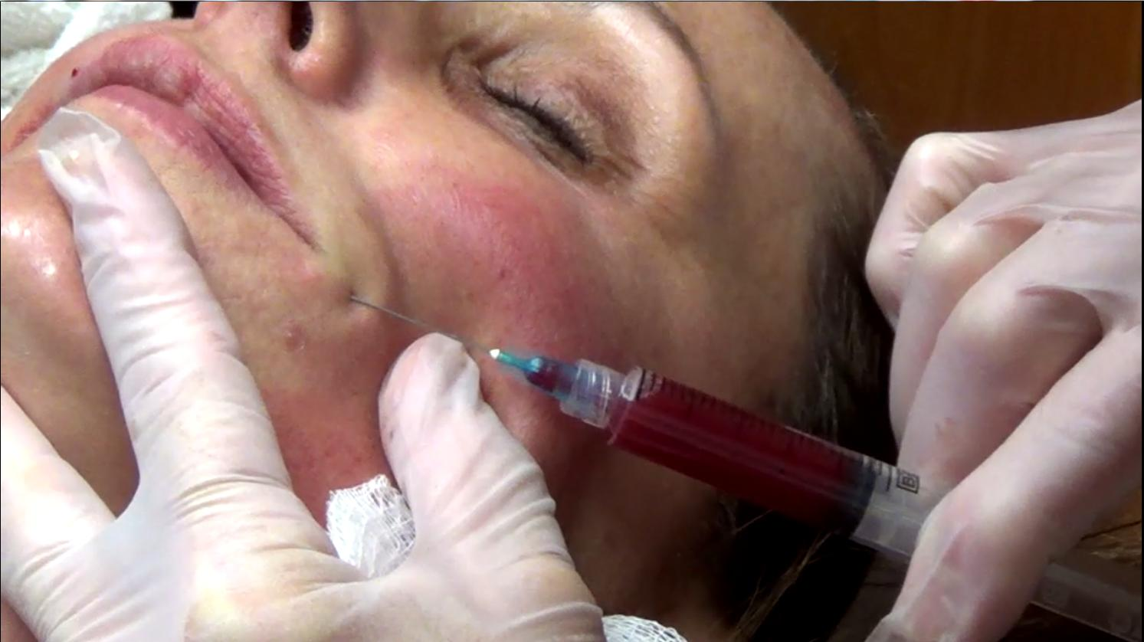
Cosmetic Applications

Slide 21
Purpose of Injecting PRP/Adipose
To induce tissue regeneration (new collagen formation) to fill in wrinkles and lines created by facial expressions, gravity, and the aging process
To revitalize skin and elasticity of the dermis
Re-awaken dormant hair follicles and stimulate vascularity

Slide 22
Magellan® TruPRP™ Enhances outcomes when combined with other treatments
Laser resurfacing → Immediate burn pain relief, Decreases redness/swelling. Accelerated healing
Microneedling-Skin Pen/Vivace → Accelerated skin rejuvenation, tightening
Ulthera → improved results reported by patients if PRP is injected prior to Tx.
Combined with fat for transfer/grafting
Hair restoration: Injection into areas of thinning on the scalp and in combination with hair transplant-Neograft

Slide 23

Collagen Induction Therapy/Hair Restoration

Slide 24
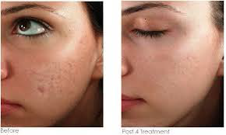
Before and Post 4 Treatments

Slide 25
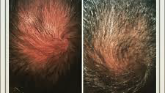
Before and after 4 PRP microneedling treatments

Slide 26
The Blood Draw
Always prime 60 ml syringe with ACD-A and flush butterfly needle tubing
Due to large bore size on butterfly needle, best to use antecubital vein or large vein. **key to producing PRP
Blood should flow 1cc/sec. If resistance is met, adjust needle in the vein until it flows easily. DO NOT pull on plunger and create a vacuum!
Stop the draw at 58 cc mark, remove needle from vein, and pull what blood is left in tubing into the syringe.
http://www.youtube.com/watch?v=YGyxYRwNcyI

Slide 27
Blood Safety and Handling
Always wear gloves when handling anything blood related.
It is a good idea to wear eye protection when drawing/injecting blood.
Always label syringes of blood with the patient’s name.
When connecting syringe of blood to disposable tubing or attaching a needle to a blood filled syringe, always use aseptic technique. *Remember, blood is a sterile, living tissue.
Anything that comes into contact with blood should be disposed of in a bio-hazard bag/container. Ex. Used syringes, left over blood in syringes, used centrifuge disposable.

Slide 28
AABB Standards for PRP
PRP should be processed and utilized at point of care. No freezing or refrigerating product for future use.
PRP should not be left at room temp for longer than 6 hours post processing.

Slide 29

Questions???

Slide 30
Vampire Breast Lift
http://www.cosmopolitan.com/style-beauty/beauty/a47323/the-vampire-breast-lift/

Slide 31
Benefits of Surgical Platelet Gel
Prevent hematoma/seroma formation
May eliminate need for drains and/or uncomfortable pressure dressings
Decreased risk of infection
Reduction in pain and postoperative swelling
Minimize scarring and bruising
Improved wound healing with shorter recovery time
Extends Life of Fat Graft

Slide 32
Surgery Center Applications for Platelet Gel
Flap procedures
Abdominoplasty (Tummy tucks)
Face Lifts
Breast Reduction/Reconstruction
Large Fat Grafting/Transfer
Buttock augmentation and labiaplasty which have not previously been considered ‘popular’ took the top spots for the most significant increases in number of procedures performed over the course of a one-year period – with buttock augmentation in the lead with a 58% increase and labiaplasty coming in second with a 44% increase compared to 2012.

Slide 33
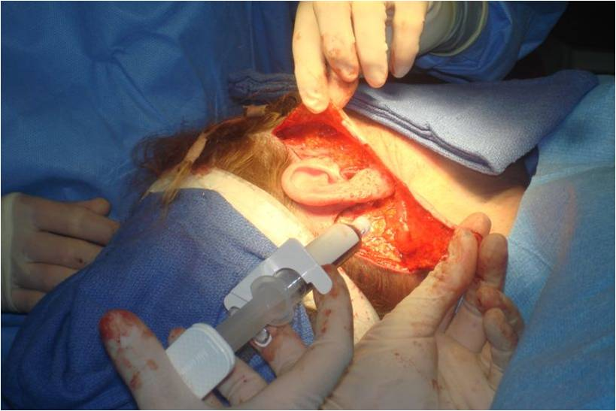
Application

Slide 34
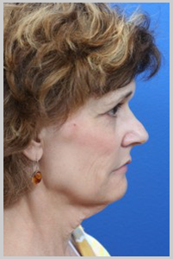
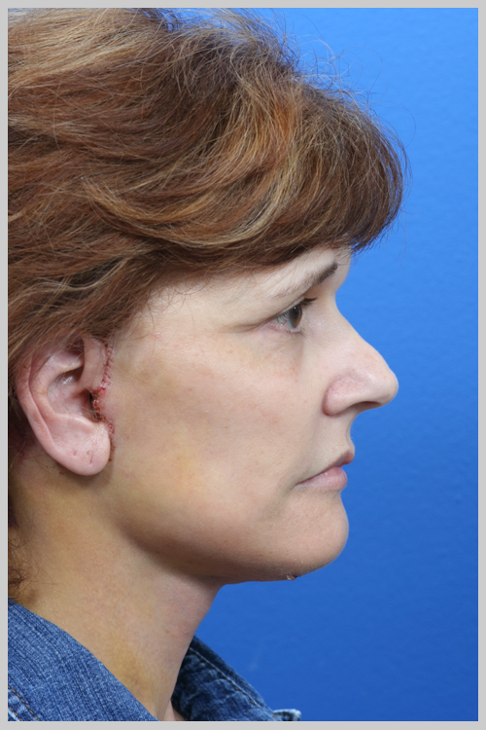
Face Lift
Before Surgery
1 Week Post Op

Slide 35
FAQ’s
Why is your PRP red?→Tru comparing systems
Will it cause bruising or look bluish when injected in the face? No, it does not cause bruising or hemosiderin staining
What causes burning on injection in the face and how can I alleviate it?
Do you need to activate your PRP with CaCl?

Slide 36
Male and Female Sexual Wellness
Common issues/Statistical data
PRP procedures being done in this space
Supportive Studies

Slide 37
Females: Urge/Stress Incontinence and Sexual Dysfunction→Statistics
60 + percent of women experiece some degree of urinary incontenence post child bearing
25% of women never experience orgasm
7-46% experience dyspareunia (based on definition)
Lichen Sclerosis: Painful, potentially scarring lesions of vulva. Comprises about 1.7% of patients in any 1 gynecologic practice. No good treatment. Increased risk of skin/vulvar cancer. PRP successful treatment
More studies are needed to collect pertinent data for PRP treatment to document safety/efficacy

Slide 38
PRP/Adipose Female Injection:
Effective for urinary stress/urge incontinence
Atrophic vaginitis or vaginal dryness improved→tissue homeostasis
Enhanced orgasm; Also helps with dyspareunia and anorgasmia, sex drive
Lichen Sclerosis-current clinical trial at Johns Hopkins with positive preliminary findings.

Slide 39
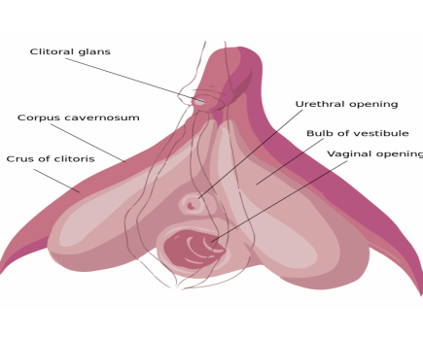
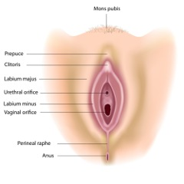
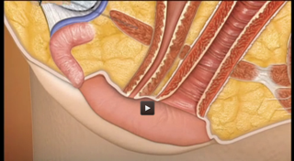
Visualization of the Technique

Slide 40
Supportive Pilot Study>O shot
Runels et al., J Women’s Health Care 2014, 3:4
http://dx.doi.org/10.4172/2167-0420.1000169
A Pilot Study of the Effect of Localized Injections of Autologous Platelet Rich Plasma (PRP) for the Treatment of Female Sexual Dysfunction
Our data indicated some degree of improvement in FSD, including positive changes in isolated sexual difficulties and in the reduction of levels of sexual distress. However, the limited number of participants in this pilot study restricts conclusions.

Slide 41
Males: Genitourinary and Sexual Dysfunction Statistics
Erectile dysfunction: affects 15-30 million men in the US. 50% of men over age 40.
Peyronie’s Disease: Affects approximately 8.9% of men in the US.
Urethral Stricture:can affect as many as 5.2% of men following treatment for prostate cancer
PRP treatments have been successful in treating all of the above, however, clinical trials to collect specific data parameters is needed.

Slide 42
BMAC/PRP +Adipose for Male Sexual Wellness;Enhancement
Improve overall erectile function both in strength of erection and increase sensation.
Peyronies-remodeling of scar tissue
Currently in clinical trial for erectile dysfunction, Peyronies disease, and urethral stricture

Slide 43
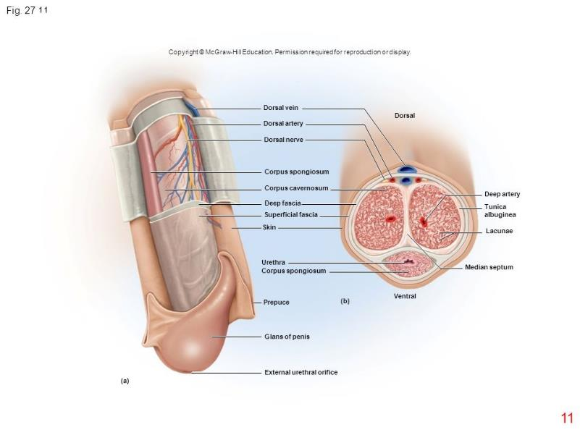
Basic Anatomy
Notes:
Corpus cavernosum: spongelike regions of erectile tissue.

Slide 44
Studies Supporting Safety and Efficacy for PRP
1. Asian J Androl. 2009 Mar;11(2):215-21. doi: 10.1038/aja.2008.37. Epub 2009 Jan 19.
The effect of platelet-rich plasma on cavernous nerve regeneration in a ratModel.
Ding XG, Li SW, Zheng XM, Hu LQ, Hu WL, Luo Y. Research Center of Urology and Andrology, Zhongnan Hospital, Wuhan University, Wuhan 430071, China.
These results show that the application of PRP to the site of CN-crush injury facilitates nerve regeneration and recovery of erectile function. Our research indicates that clinical application of PRP has potential repairing effect on CN and peripheral nerves.

Slide 45
Regenerative Medicine/Anti-Aging Markets
Sports Medicine/Pain Management-
MSK injections
Notes:
Call point with highest potential volume over the next 5-10 years

Slide 46
Statistics
Musculoskeletal disorders and diseases are the leading cause of disability in the United States and account for more than one-half of all chronic conditions in people over 50 years of age in developed countries. One in two adults report a musculoskeletal condition requiring medical attention.
Annual direct and indirect costs for bone and joint health are 950 billion – 7.4% of the gross domestic product. (2006)
The Sports Medicine Practitioners industry is in the growth stage of its life cycle, with revenue expected to grow at a faster rate than US GDP.(IBISWorld’s Sports Medicine Practitioners market research report)
There are approximately 10,000 board certified physiatrists in the United States who are trained to diagnose, treat, and direct a rehabilitation plan that provides the best possible patient outcomes focusing on functional ability and quality of life.
http://health.usnews.com/doctors/location-index/pain-management-specialists
Notes:
Realize the opportunity before us.

Slide 47
Call points for MSK Injections
Non-operative Sports Medicine/Prolotherapists
Pain Management→ Anesthesiologist/Physiatrist/PM&R
DO’s and Interventional Radiologist
Spine Surgeons→ Neuro and Ortho
Podiatrists
Orthopedic Surgeons

Slide 48
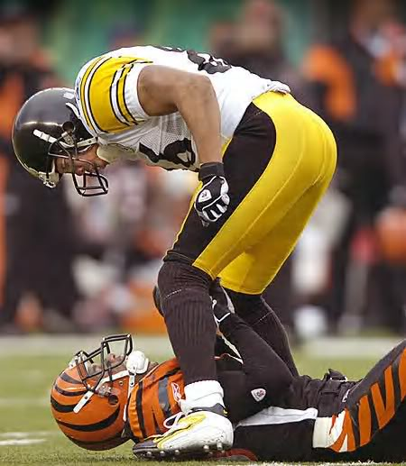
Why the interest
Autologous
Enhanced healing
Potential enhancement of recruitment, proliferation and differentiation of cells that are involved in healing and regeneration
Hines Ward
Notes:
We now have the capability of offering a non-invasive option between conservative therapy, PT, anti-inflam… and Surgery.

Slide 49
PRP Nomenclature Defined
A tissue graft incorporating autologous growth factors and/ or autologous undifferentiated cells in a cellular matrix whose design depends on the receptor site and tissue of regeneration. (Crane, et al; 2008)

Slide 50
Natural, Biologic Processes
Chemoattraction
Migration
Differentiation
Proliferation
Notes:
Signal proteins released from damaged tissue call in stem cells from surrounding vasculature and begin the proliferation/differentiation process in a healthy individual.

Slide 51
PRP Studies: What is missing?
Lab analysis of the final PRP product:
Baseline platelet count
Platelet count/ml in PRP or concentration above baseline
Platelet activation in final PRP product
Consistency of product used in each patient
How was PRP processed? System used?

Slide 52
PRP Classifications--Mishra
 | White Blood Cells | Activated?
Type 1 | Increased over baseline | No
Type 2 | Increased over baseline | Yes
Type 3 | Minimal or no WBC’s | No
Type 4 | Minimal or no WBC’s | Yes
A: >5x platelets
B: <5x platelets

Slide 53
Concern over WBC’s/Leukocytes
Inflammatory?? Main concern in intra-articular or intradiscal injections.
El Sharkaway→ in 5X baseline platelet concentration, anti-inflammatory
Leukocyte-rich PRP-type 1 A vs Leukocyte-poor PRP- type 3B vs whole blood (Parrish-In-vitro)
Despite the evidence for type 1 A PRP, many are still wanting a Type 3 B option. Magellan CAN provide!

Slide 54
When to use PRP vs cBMA??
Bone marrow contains IRAP-interleukin receptor antagonist protein. Natural anti-inflammatory. In cBMA, level of IRAP is concentrated.
Soft tissue injuries→PRP
Osteo-arthritis→cBMA
Degenerative Disc Disease→cBMA + PPP
What about patient’s with multiple comorbidities?

Slide 55

Potential Comorbidities
Diabetics
Smokers
Elderly
Unhealthy
May have different challenges, but all display impaired healing.
Notes:
Immuno pts vascular iss
Transport issues
*Replacement Effect
*Trophic Effect
Other concerns? > Age?

Slide 56
How is PRP Utilized in MSK?
Soft tissue injuries treated with PRP include tendonopathy, tendonosis, acute and chronic muscle strain, muscle fibrosis, ligamentous sprains, and joint capsular laxity. PRP has also been utilized to treat intra-articular injuries. Examples include arthritis, arthrofibrosis, articular cartilage defects, meniscal injury, and chronic synovitis or joint inflammation.(Crane,et al 2008)

Slide 57
Sports Medicine/Pain Management Applications for TruPRP/TruMAR0
Musculoskeletal Injuries→epicondylitis, plantar fasciitis, Achilles tendonitis, etc.
Osteoarthritis
Back/neck pain→DDD, annular tears, facet joints, etc.
Current trials proposed or ongoing utilizing PRP or cBMA with chronic wounds, headaches, degenerative disc, articular cartilage regeneration and TMJ.

Slide 58
Therapeutic Goal of PRP
Inflammatory
Proliferation
Regenerative
Pro
Anti
Normal Healing
Accelerated Healing
Cleansing
Debridement
Chemotaxis
Fiber accumulation
Matrix remodeling
Notes:
The goal of providing concentrated growth factors to a specific tissue site is to accelerate the natural healing and tissue regeneration process. When injecting PRP into tissue, the needle stick creates a tissue injury causing this process to begin.

Slide 59
Protocols for Injection therapy
No anti-inflammatory meds for at least 48 hours prior to procedure
At least 1 month post steroid injection
No anti-inflammatory meds for at least 1 week, preferably 4 weeks post injection.
Movement is critical, but no high intensity (Pain guided activity)
Expect a roller coaster effect for 4-6 weeks following injection. May require repeat injection/s depending on response.
*The healthier the patient, the better the response!

Slide 60
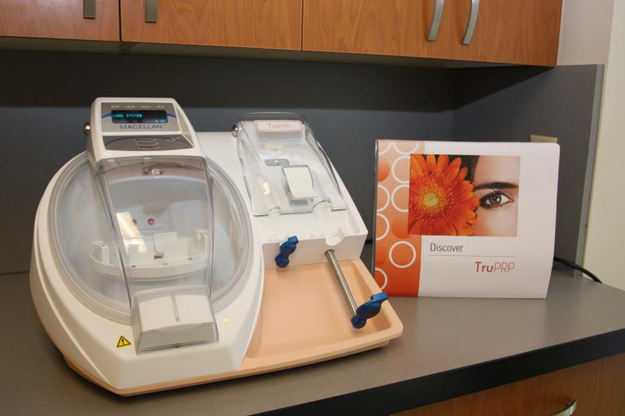
Why TRUPRP?
(picture of newly designed device)

Slide 61
Key Delivery Considerations
Consistent
  Relatively error-free delivery of desirable concentrated cells.
Reproducibility
  Automated with intelligent detection capabilities
Safety
  Closed system with physical barriers
Easy to use
  Minimal operator involvement

Slide 62
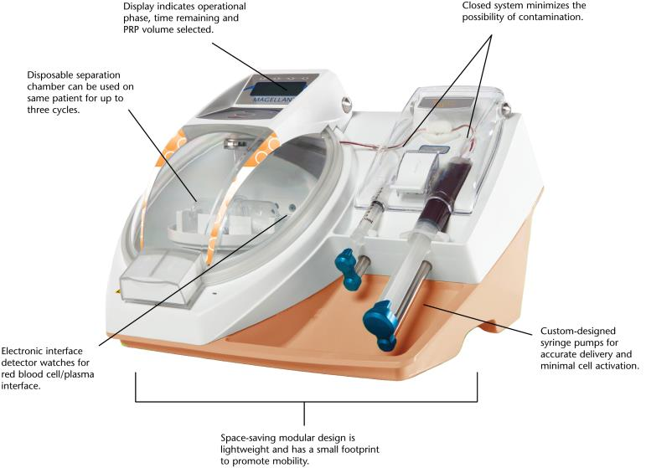
The Magellan® Platform
Notes:
New machine will be pictured here

Slide 63
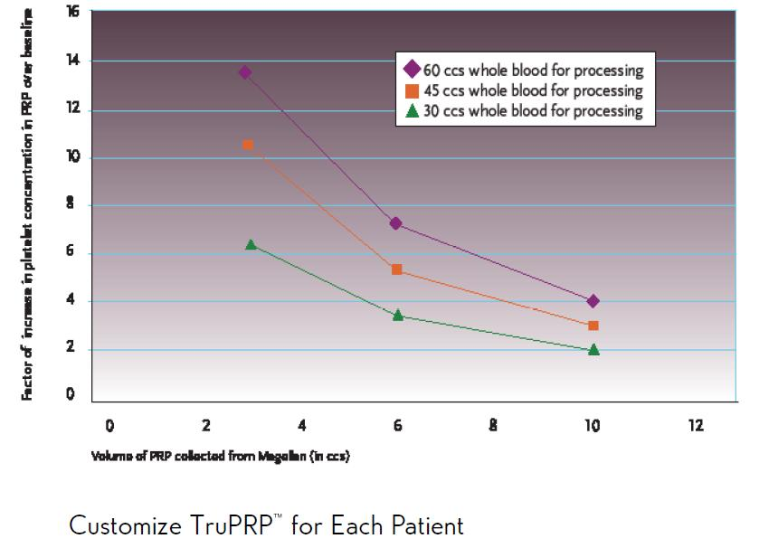
Volume Customization

Slide 64
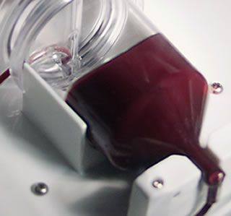
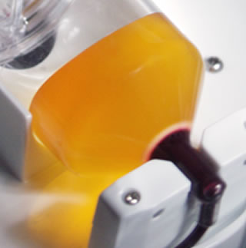
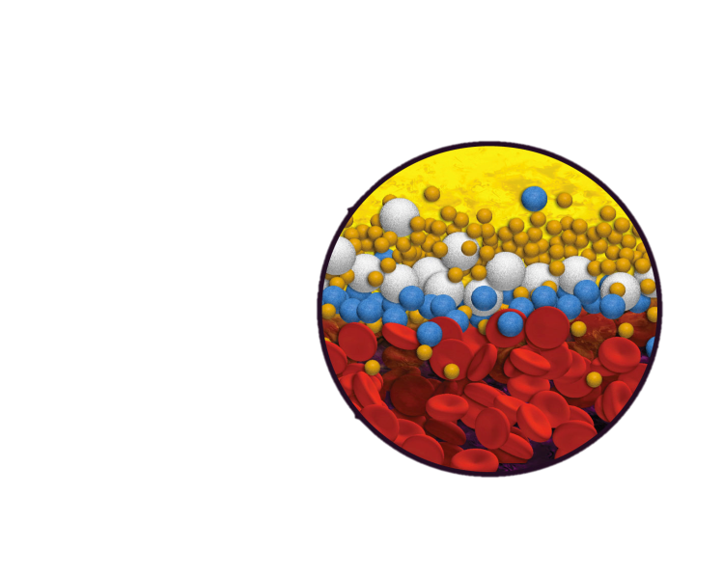
Cell Separation and Concentration in Magellan-Red PRP
1
2
3
Platelets
White Blood Cells
Progenitor Cells
Red Blood Cells
Notes:
Utilize this in every sales call! Use the Comparison of Systems marketing piece for the Tru line.

Slide 65
Magellan® vs. Competition
Fully automated→No cell manipulation/self balancing
Actual buffy coat produced→red PRP
PPP automatically collected
Customizable PRP volume and cell concentration(3-30 mL of PRP/kit) plus PPP
One kit size

Slide 66
Competition—Selphyl/Eclipse
Single spin systems-NOT PRP!
Single spin centrifuge →Does not produce a buffy coat
Essentially platelet-poor plasma →yellow in color, small volume acquired
Manual manipulating of product → potential cell damage, exposes user to blood products
Kit cost ranging from $350-$500 across the country

Slide 67

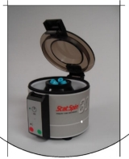
Single Spin Centrifuges; Selphyl and Regen
These are nothing more that old technology, lab centrifuges.
They SEPARATE, not CONCENTRATE

Slide 68
Single Spin Systems Explained
Most platelets are not harvested.
Whole Blood
“System A’s” IFU instructs user to remove all but 1 to 2 cc’s of the plasma nearest the red cells
Platelet-Poor Plasma
Centrifugation
Platelets
The concentrated platelets are located here (This is the volume that “System A” instructs the user to leave.)
Red Cells
10 ml
Notes:
If PRP is not red, there are very few if any platelets

Slide 69
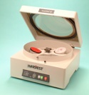
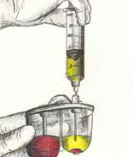
Harvest SmartPrep 2-Dual spin

Slide 70
Key Selling Points Against Harvest
4 breaks in sterile disposable chamber required→increased risk of contamination
Multiple manipulations on the cells→potential cell damage, premature platelet activation and unnecessary blood exposure to the user
Inconsistent product→user dependent/hematocrit dependent
Potential for kit wasting

Slide 71
Angel System: Arthrex/Cytomedix
Microprocessor driven centrifuge capable of processing up to 180ml of blood or bone marrow at once.
Roller pump- basic cell saver, CP bypass technology—causes some cell damage
Bladder bag disposable—large surface area→inconsistent cell counts at times
Kit prices currently being increased
Very few machines available

Slide 72
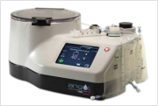

Slide 73
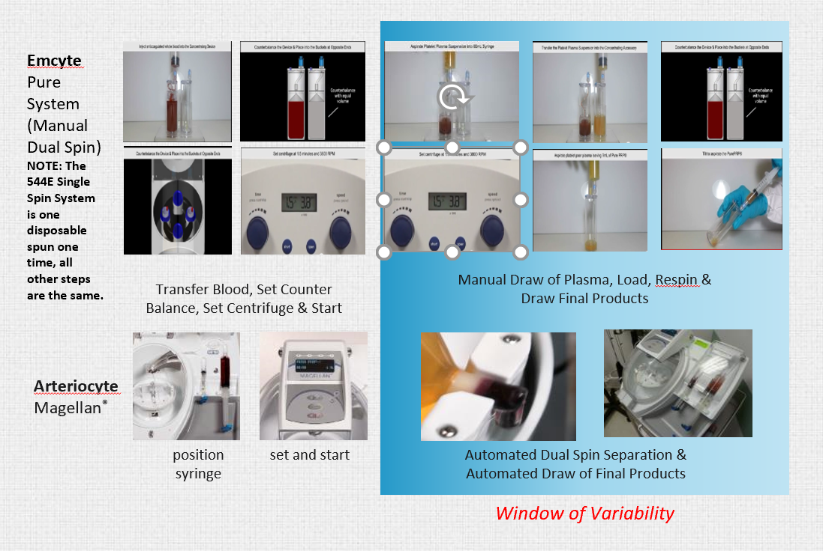
Manual Systems

Slide 74
Frequently Asked Questions
Before the sale…Supportive materials
Why is your pricing so high? (closed system,customize, volume)
Why is Magellan PRP Red?(Tru comparing systems)
Is there concentrated Leukocytes in your PRP? (comparison Paper-clinical team member discussion)
How does Magellan compare to the competition in terms of cell concentrations? (Emcyte, Harvest, Angel, Eclipse, Regen)
Do you provide training on the bone marrow aspiration?

Slide 75
FAQ’s About TRUPRP
Why is TRUPRP red?
What is the difference between Magellan TRUPRP and the competition? (Selphyl, Regen, Harvest, Angel, Emcyte)
How can you customize PRP in Magellan?
Do the red cells cause hemosiderin staining?
What are some of the applications for TRUPRP?
When will the results be apparent?
How long will results last?
How many injections does it require to achieve desired effect?
How often are maintenance treatments required?

Slide 76
Key Delivery Considerations
Consistent/customizeable
  Relatively error-free delivery of desirable concentrated cells. Therapeutic concentrations higher than any other system.
Reproducibility
  Automated with intelligent detection capabilities
Safety
  Closed system with physical barriers
Easy to use
  Minimal operator involvement

Slide 77
Questions???

