Slide 1

Formulation Rationale
Leukocyte Rich vs. Leukocyte Poor Biologics
Educational Resource Review
Overview of the Components in Platelet Rich Plasma (PRP) and Their Roles in Healing
Shawn Piasecki, PhD
Scientific & Clinical Affairs
Thursday, August 29, 2019 - 3pm EST

Slide 2
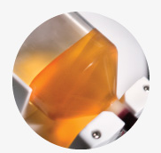
PRP Components & Functions
Plasma: 1.025 – 1.029 g/ml
Transport nutrients, blood cells, provide clotting factors
Monocytes: 1.062 – 1.068 g/ml
Release MMPs to regulate turnover of ECM, allowing for cellular migration and induction of
healing. Transform into macrophages, secrete GFs to support neoangiogenesis, remove neutrophils
Platelets: 1.060 – 1.067 g/ml
Store GFs & Cytokines, Regulate Hemostasis, attract WBCs
Lymphocytes: 1.068 – 1.072 g/ml
Release factors to control inflammation & regulate cell growth
Neutrophils: 1.080 – 1.090 g/ml
Migrate to damaged tissue, induce phago-cytosis of debris, necrotic tissue and microbes
Erythrocytes: 1.086 – 1.100 g/ml
Increase activation & release of cytokines from platelets
Pavlovic, V et al. (2016) Platelet Rich Plasma: a short overview of certain bioactive components. Open Med. 11, 242 – 247.
Notes:
PRP is concentrated into six main layers. Mention that leukocytes are another word for WBCs.
Neutrophils are considered granulocytes and there are also two other forms: Eosinophils & Basophils, but they are present in very low (sometimes undetectable) concentrations. Each layer overlaps in the density gradient and plays an important role in the healing process.

Slide 3
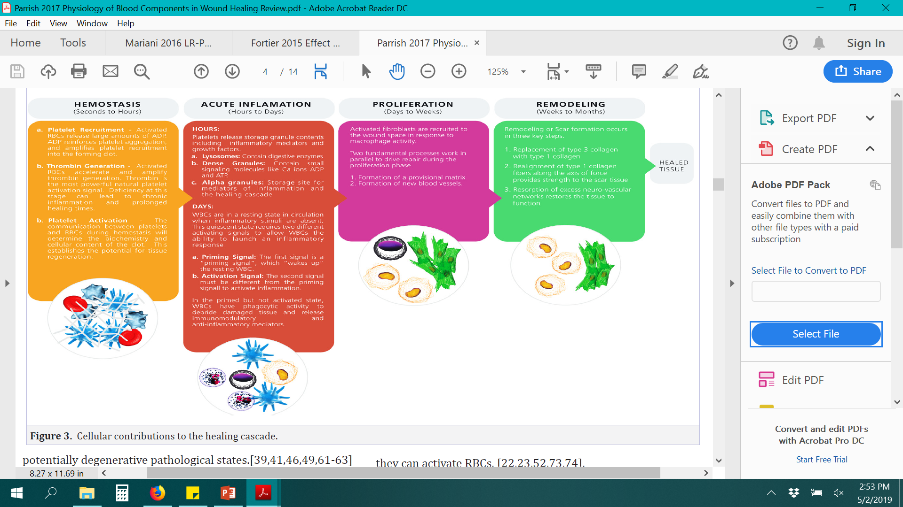
WBC Roles in Healing
“None of the components of whole blood functions alone in the normal physiology of wound healing. Cellular co-operativity is important for execution at each phase of the healing cascade.”
Parrish, WR and Roides, B (2017) Physiology of Blood Components in Wound Healing: an Appreciation of Cellular Co-Operativity in Platelet Rich Plasma Action. J Exerc Sports Orthop 4, 1 – 14.
Notes:
Thrombin production is very important to transition from hemostasis to acute inflammation. RBCs play an important role in amplifying thrombin generation to ensure effective execution of initial two phases.
Activated platelets and primed neutrophils cooperate in the biosynthesis of factors that control the magnitude and duration of inflammation.
Pain mediators and inflammatory cytokines are inactivated. GFs are activated for proliferation, angiogenesis, and new matrix synthesis.

Slide 4
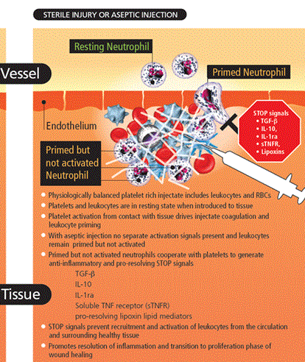
WBC Roles in Healing
Neutrophils work with platelets to control magnitude & duration of inflammation by producing STOP signals. This prevents further recruitment & activation of WBCs from circulation & surrounding tissues.
Thus promoting: *Resolution of inflammatory phase,
*Accelerating transition to proliferation phase
Parrish, WR and Roides, B (2017) Physiology of Blood Components in Wound Healing: an Appreciation of Cellular Co-Operativity in Platelet Rich Plasma Action. J Exerc Sports Orthop 4, 1 – 14.
Notes:
-Neutrophils require separate priming & activation signals to elicit an inflammatory response. In the context of a percutaneous injection there is no separate neutrophil activation signal available. (it acts like a bruise healing – healing with little to no inflammatory phase)
-Mediators released from primed but not activated neutrophils can suppress inflammation and prevent the further recruitment of activated cells.

Slide 5
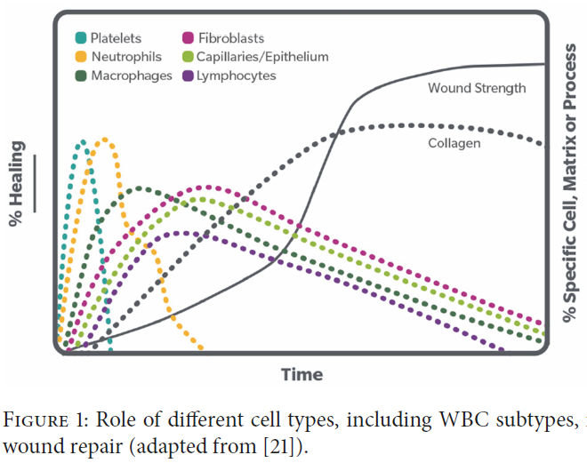
Defining LR-PRP & LP-PRP
Platelets Contain GFs, but Also Recruit WBCs to Damaged Tissue
  Platelets arrive at wound site, degranulate, release contents (GFs, clotting factors, etc).
  Activated platelets secrete chemokines which attract WBCs (neutrophil recruitment & binding to wound site)
  Platelets also have p-selectin on their surface which binds circulating WBCs
WBCs are Adaptive
  WBCs can be inflammatory & hinder tissue repair (i.e., active infection)
  WBCs can induce tissue repair for normal healing processes
cBMA Contains a Complex Mixture of Cell Types
  WBC-rich cBMA has favorable safety profile, MSCs are anti-inflammatory
  Monocytes & neutrophils secrete IRAP ∴ reducing WBCs will reduce [IRAP]
Parrish, WR and Roides, B (2017) Physiology of Blood Components in Wound Healing: an Appreciation of Cellular Co-Operativity in Platelet Rich Plasma Action. J Exerc Sports Orthop 4, 1 – 14.
King, W et al. (2018) Role of White Blood Cells in Blood- and Bone Marrow-Based Autologous Therapies. BioMed Research International, Article ID 6510842.
Hendrich, C et al. (2009) Safety of Autologous Bone Marrow Aspiration Concentrate Transplantation: Initial Experiences in 101 Patients. Orthopedic Reviews 1, 99 – 103.
Hernigou, P et al. (2013) Cancer Risk is not Increased in Patients Treated for Orthopaedic Diseases with Autologous Bone Marrow Cell Concentrate. JBJS 95, 15 – 21.
Centeno, CJ et al. (2016) A Multi-Center Analysis of Adverse Events Among 2,372 Adult Patients Undergoing Adult Autologous Stem Cell Therapy for Orthopaedic Conditions. Int. Orthop. 40, 1755 – 1765.
5
Notes:
Aside from an injection, this is what normally happens in the body.
This “toggling” effect could (in part) explain why LR-PRP injections have been shown to be effective without any SAEs, despite containing concentrated WBCs.

Slide 6
Defining LR-PRP & LP-PRP
What are we defining as LR vs. LP?
Do we really need to deplete all WBCs in PRP, or just a subset?
  What definition do we agree on as a group?
    Total WBC reduction?
    Granulocyte (Neutrophil) reduction?
  Constraints of current concentration systems
Understanding the biology of WBCs in healing cascade
  All WBCs are not the same
  How does the PRP formulation work with patient needs?
General Consensus (or at least what I think it is):
  Sometimes we would like to reduce neutrophils (below baseline)
  Redefining our definition of LP to “neutrophil-reduced”
  Some applications will benefit, others won’t (look to clinical literature)
“A key role of even pure PRP is to recruit WBCs to a wound.”
–King 2018
6
Notes:
-We need to standardize the definition of LR vs. LP formulations.
-Issues with depleting platelet & SC yields when you push further into the buffy coat layer to deplete more WBCs (delicate balance).
-Hint toward next-gen systems that will be able to maintain platelet & cell yield while reducing WBCs & RBCs.

Slide 7
Hematocrit Effects to Consider
Magellan is a Low-Hct Concentration System
  There is no clinical evidence stating a specific Hct% is best (in any application)
  Braun 2014: there was 12.5 ± 6.9% synoviocyte death when RBCs were added to synoviocyte culture, but that number can be reduced:
    Emcyte LR-PRP (Absolute, 25 – 40% Hct): 4.9 ± 3.1% death
    Emcyte LP-PRP (PurePRP, 1 – 9% Hct): 0.72 ± 0.7% death
    Magellan Standard (8 – 12% Hct) & Magellan MinRBC (1 – 3% Hct)
Disclaimer: No published clinical benefit to using any one system over another
  Gaul 2018: Reviews this, but notes that there is a clear patient safety benefit to using a fully-automated, closed-loop vs. manual system
Braun, HJ et al. (2014) The Effect of Platelet-Rich Plasma Formulations and Blood Products on Human Synoviocytes: Implications for Intra-articular Injury and Therapy. Am J Sports Med. 42, 1204 – 1210.
Gaul, F et al. (2018) A Review of Commercially Available Point-of-Care Devices to Concentrate Bone Marrow for the Treatment of Osteoarthritis and Focal Cartilage Lesions. Cartilage [Epub ahead of print]
Notes:
Only Hct effects on synoviocytes have been tested. This may or may not hold true for other applications (tendon/muscle/ligament/bone)
Do not ever tell a doc that the Magellan System produces the best clinical outcomes (never been tested)

Slide 8
Clinical Literature is starting to build:
LR-PRP vs. LP-PRP: When to Use?
The clinical benefit of using LR vs. LP vs. Pure is still not clear for many applications
There are only 2 head-to-head trials of LR- vs. LP-PRP (knee OA & Achilles tendinopathy) which observed no difference in patient reported pain relief, although more pain and swelling occurred initially in the LR groups. (Filardo 2012, Hanisch 2019)
  Young pts, & pts with low degree of cartilage degeneration did clinically best
  A meta-analysis of PRP knee OA studies showed no difference in adverse event incidents between LR- vs. LP-PRP (Riboh 2016)
However, high level studies support using the following (Le 2019):
  Lateral Epicondylitis: LR-PRP
  Knee OA: LP-PRP
  Patellar Tendinopathy: LR-PRP
  High Ankle Sprains: LP-PRP (potential)
Filardo, G et al. (2012) Platelet-rich plasma intra-articular injections for cartilage degeneration and osteoarthritis: single- versus double-spinning approach. Knee Surg Sports Traumatol Arthrosc. 20, 2082 – 2091.
Hanisch, K & Wedderkopp, N (2019) Platelet-rich plasma (PRP) treatment of noninsertional Achilles tendinopathy in a two case series: no significant difference in effect between leukocyte-rich and leukocyte-poor PRP. Ortho Res & Rev 11, 55–60.
Riboh, JC et al. (2016) Effect of leukocyte concentration on the efficacy of platelet-rich plasma in the treatment of knee osteoarthritis. Am J Sports Med. 44, 792 – 800.
Le ADK et al. (2019) Platelet-rich plasma. Clin Sports Med. 38, 17 – 44.
Notes:
Make note that sales (& clinical) should NEVER be making recommendation as to which formulation to use. If a doc asks, all we can do is give them the literature and have them decide which is more appropriate for their patient.

Slide 9
Not a very clear answer, but:
PRP vs. cBMA: When to Use?
The literature tends to favor cBMA for more “difficult” to treat circumstances (further degradation, larger tears, fractures, etc.)
There is also high-level literature supporting the use of cBMA (LR) for knee OA
  Upadhyay 2014 (I), Goncars 2017 (II), Garay-Mendoza 2018 (II)
I thought you just told me LP-PRP was shown to work best for knee OA…
  PRP repair mechanism unlikely involves direct mediation of chondrogenic repair (Liou 2018) and rather to fix a physiologic issue (such as pH, inflammatory signaling, signaling cellular activity, etc),
  cBMA treatment may provide viable cells to repair the damaged tissue
  Best to choose PRP/cBMA based on patient need
Upadhyay, S et al (2014) Randomized blinded comparative analysis of autologous mononuclear medullary fraction and viscosupplementation in grade 0 and grade 1 radiographic scale of knee osteoarthritis. Indian J Pain 28, 134 – 142.
Goncars, V et al (2017) The comparison of knee osteoarthritis treatment with single-dose bone marrow-derived mononuclear cells vs. hyaluronic acid injections. Medicina 53, 101 – 108.
Garay-Mendoza, D et al (2018) The effect of intra-articular injection of autologous bone marrow stem cells on pain and knee function in patients with osteoarthritis. Int J Rheum Dis. 21, 140 – 147.
Liou, JJ et al (2018) Effect of Platelet-Rich Plasma on Chondrogenic Differentiation of Adipose- and Bone Marrow-Derived Mesenchymal Stem Cells. Tissue Engineering. 24, 1432 – 1443.
Notes:
Again, the doc should be making this decision, not you!

Slide 10
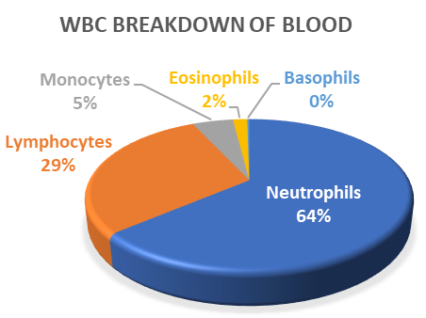
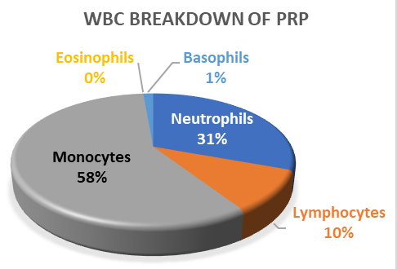
Magellan Yields
Though Magellan® is considered a Leukocyte Rich (LR) concentration device, Cassano 2016 shows that the standard cycle produces a Neutrophil-reduced concentrate:
  Reduces neutrophils by ~0.48x baseline but concentrates helpful Monocytes by 11.6x baseline.
  The standard cycle also produces a high number of platelets (~8x baseline), MSCs (5.3x baseline CFU-fs), and HSCs (~5-6x baseline) (internal data).
Breakdown of WBC Components Before & After Centrifugation with Magellan System
Standard cycle:
~8x Platelets
~5 – 6x MSCs/HSCs
Reduced Neutrophils
Low Hct
Cassano 2016
Notes:
Don’t call the MinRBC setting LP. You can say “further neutrophil-reduced”

Slide 11
To Summarize
WBCs all work together to heal a wound site. Not all WBCs are “bad”
Depending on their environment, WBCs can hinder or induce healing:
  Platelets degranulate and release GFs/cytokines, which recruit WBCs to the wound site
  Injected Platelets & WBCs work together to push wound healing cascade forward
Platelet and GF yields are decreased when WBCs are depleted (with current concentration systems)
Magellan’s low Hct may not significantly affect synoviocyte viability
More literature is needed to truly define best formulation for application

Slide 12
Questions?

